Slide 1
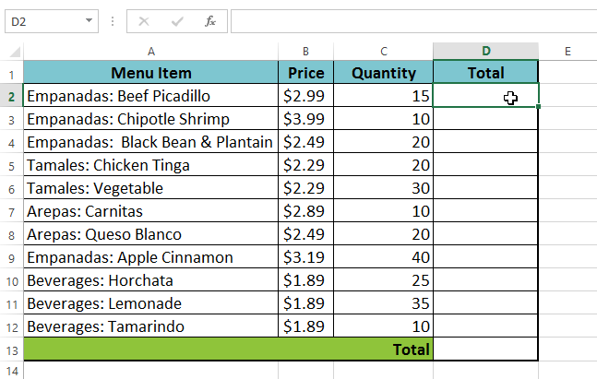
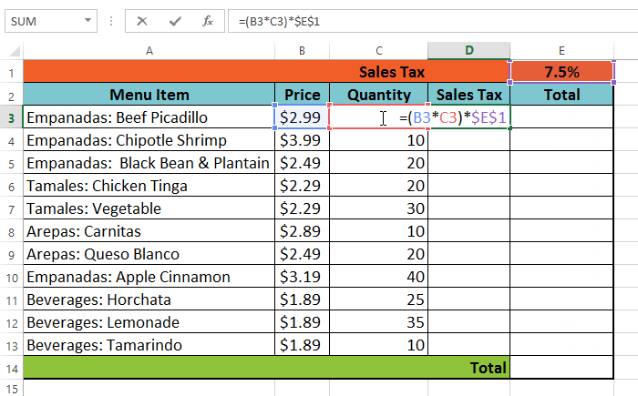
Relative Addressing in Excel
=B3*C3
=B4*C4
=B5*C5
Absolute Addressing in Excel
=(B4*C4)*$E$1
=(B5*C5)*$E$1
=(B6*C6)*$E$1

Slide 2
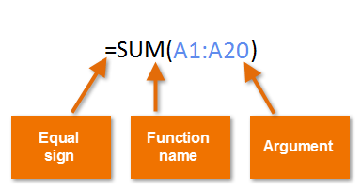
Order of Operations in Excel 1) Parentheses First ( )
2) Exponents Next ^
3) Multiplication and Division (left to right) * /
4) Addition and Subtraction (left to right) + -
FUNCTIONS (Formulas Big Brother)

